Slide 1
UTA CASE STUDY
SALT LAKE CITY
January 12, 2023
Chris Gallegos
-Data analyst

Slide 2
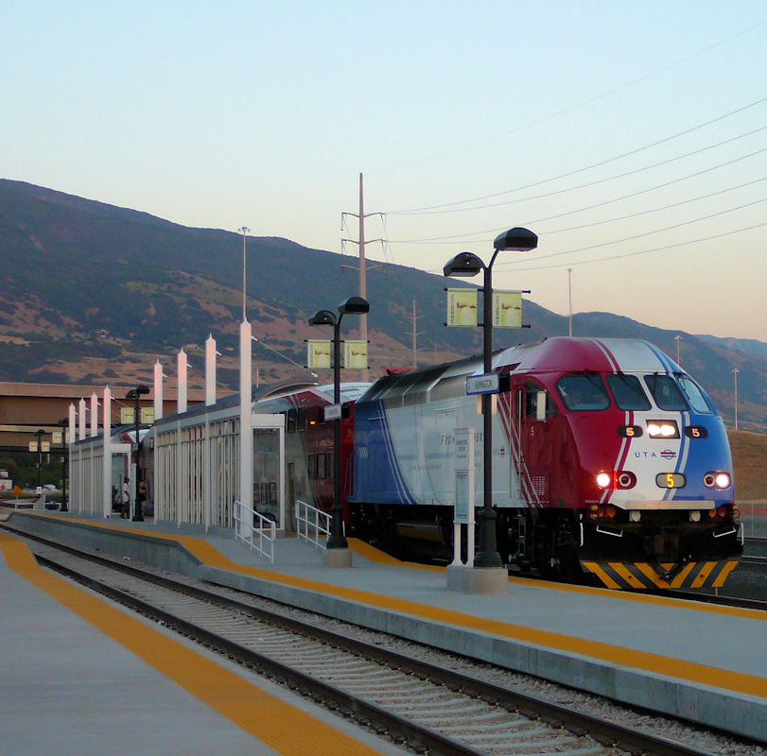

Introduction
Vanloop Analysis
Technical
Define Tech Strategy
ETL
Analyze
Business Analysis
Visualize
Recommendations
Conclusion and Questions

Slide 3
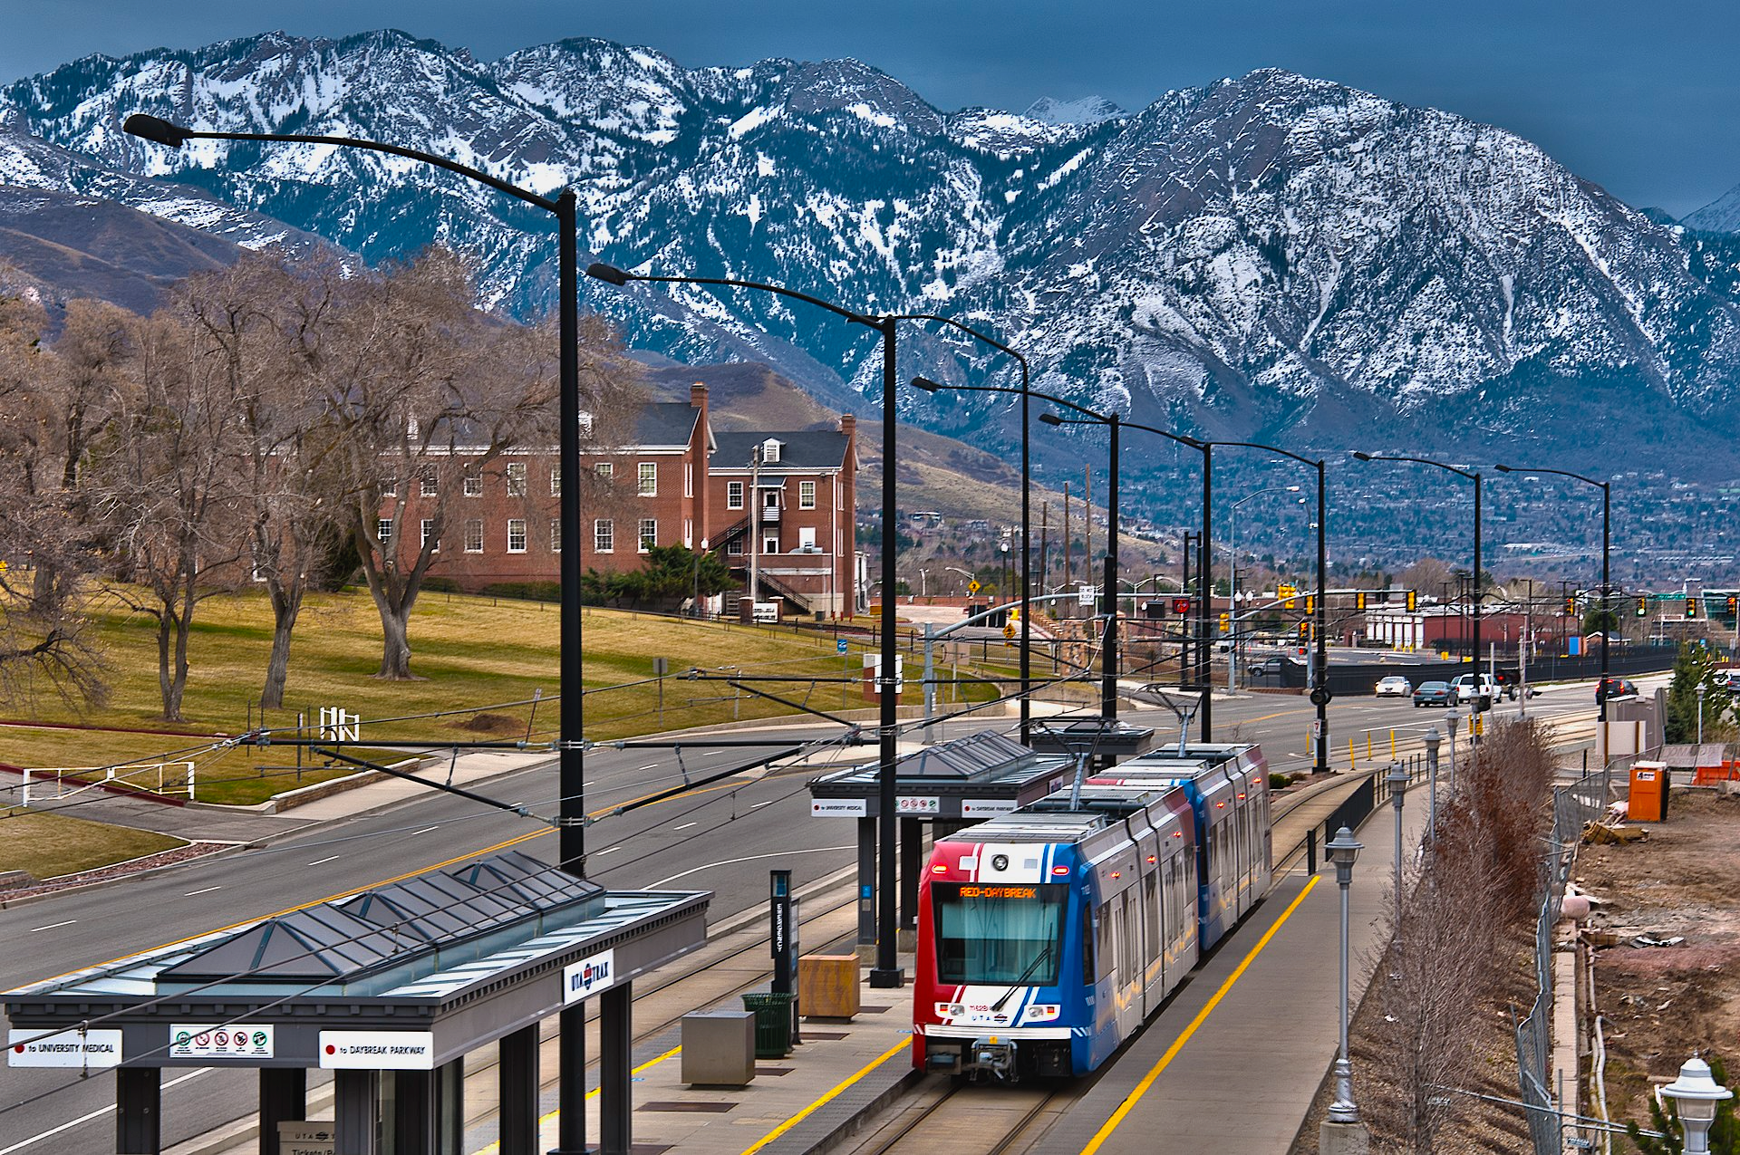
TECH STRATEGY
GitHub
MySQL Workbench
Tableau
Power Point

Slide 4

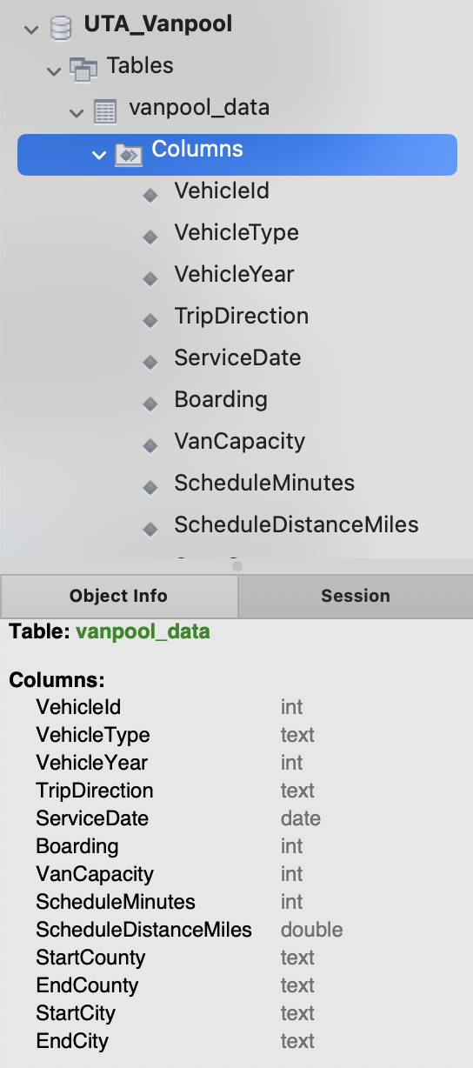
First Step: ETL
MySQL Workbench
Converted provided .xlsx to .csv
Formatted dates to align with SQL data type DATE()
Imported data to SQL Database

Slide 5

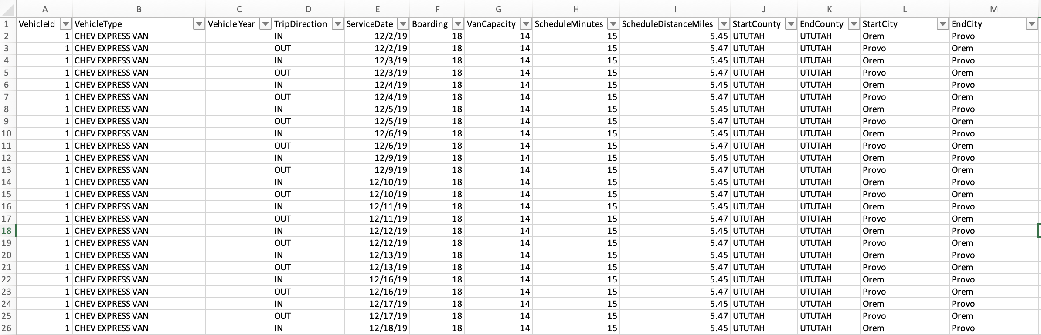
Second Step: Analyze
MySQL Workbench
Data corresponding December 2019 and January 2020
Units in service: 194

Slide 6
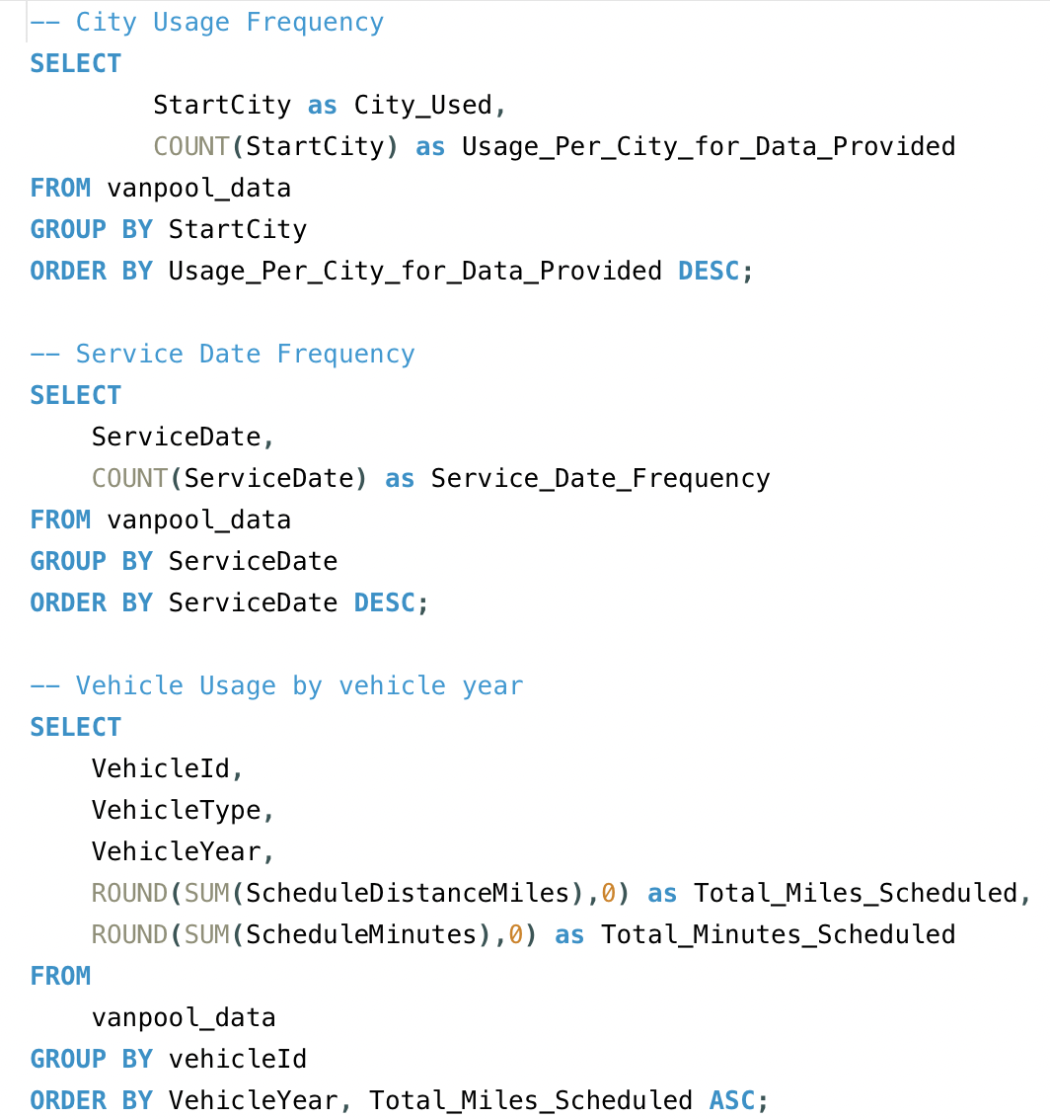
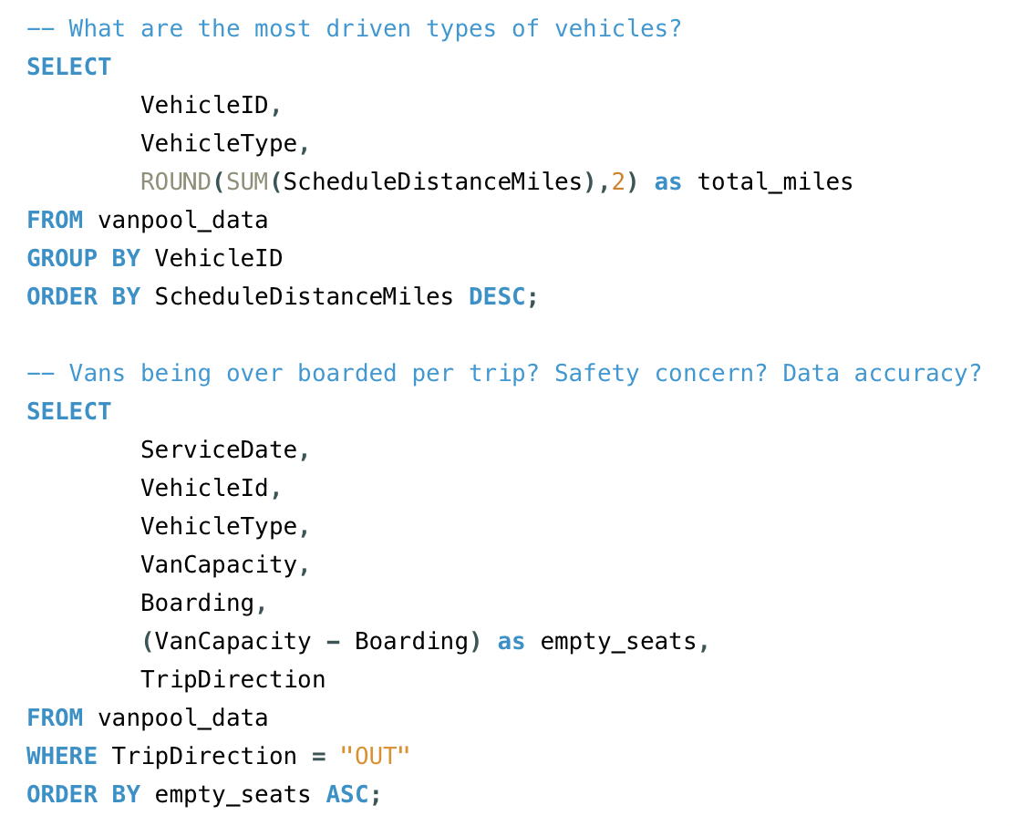
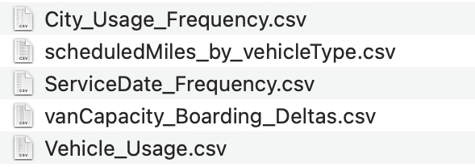
Second Step: Analyze
MySQL Workbench
Query defining questions
What are the most driven types of vehicles?
Vans being over boarded? Safety concern? Data accuracy?
City Usage Frequency
Service Frequency by Date
Vehicle Usage by vehicle’s year
Exported 5 tables for visualization

Slide 7


Third Step: Visualize
BEGIN TABLEAU PRESENTATION

Slide 8
Recommendations
OPERATIONAL
STRATEGIC
Assess feasibility ASAP for Vehicles that are being driven the most in terms of miles and time.
Consider rotating vehicle locations for a more “balanced“ use.
Prioritize maintenance for vehicles with high usage.
Determine whether vehicles being over boarded is a misunderstanding in data or an actual safety concern.
Maintain analysis of service use trends by location and date.
Schedule customer and operational support for high volume days in Salt Lake Metro Area.
Begin marketing efforts on the subsequent 5 areas of most usage as to increase market share.

Slide 9
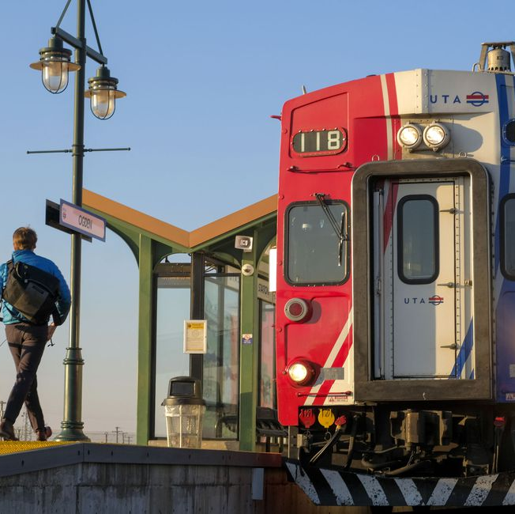
Conclusion And Questions
Focus on communicating competency on my technical skills
Focus on strategy and business acumen
Analyze the data and find patterns/directions
Strategic and Operational Recommendations

Slide 10
Conclusion And Questions
Thank you for your time and attention. I am happy to answer any questions!

